Slide 1
Build Models to Predict White Wine Quality by Data Mining from Physicochemical Properties of Wine Quality Data
Critical Thinking Group1
Data 621 Final Project

Slide 2
Introduction
Vinho Verde exclusively produced in the demarcated region of Vinho Verde in northwestern Portugal. It is only produced from the indigenous grape varieties of the region, preserving its typicity of aromas and flavors as unique in the world of wine.
There are many psychochemical tests involved behind the quality of wine. Our goal is to predict the wine quality based on various psychochemical tests.

Slide 3

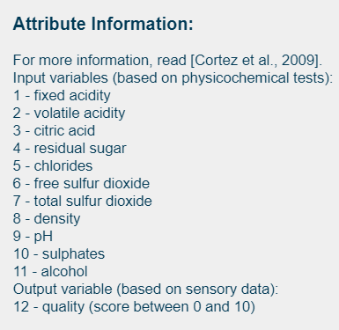
DATA Source
Got from UCI machine learning repository
(https://archive.ics.uci.edu/ml/datasets/Wine+Quality)
Two datasets were built based on red and white vinho verde wine samples from the north of Portugal.

Slide 4
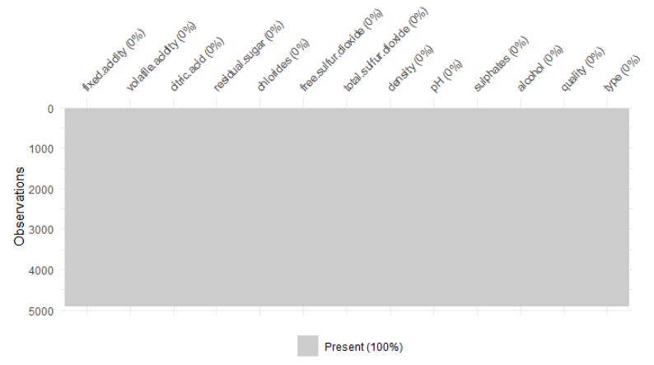
Figure 1. No missing data in the dataset

Slide 5
Variables in Dataset
(1) Fixed acidity: a measurement of the total concentration of titratable acids and free hydrogen ions present in the wine. (2)Volatile acidity: a measure of steam distillable acids present in a wine. (3) Citric acid: one of the many acids that are measured to obtained ﬁxed acidity. (4) Residual sugar: measurement of any natural grape sugars that are leftover after fermentation ceases. (5) Chlorides: the amount of salt in the wine. (6)Free sulfuric dioxide: the free form of SO2 exists in equilibrium between molecular SO2 (as a dissolved gas) and bisulﬁte ion; (7) Total sulfuric dioxide: amount of free and bound forms of SO2; (8) Density: measure of density of wine. (9)pH: value for pH. (10) Sulfates: a wine additive which can contribute to sulfur dioxide gas (S02) levels, which acts as an antimicrobial and antioxidant. (11) Alcohol: the percentage of alcohol present in the wine. (12) Quality: subjective measurement ranging from 1 to 10 (although the observed data ranges from 3 to 8).

Slide 6
Table 1. Summarize the variables of Data Set
Variable Name | Min | 1st.Q | Median | 3rd.Q | Max | Mean | SD
Fixed.acidity | 3.80 | 6.30 | 6.80 | 7.30 | 14.20 | 6.86 | 0.844
Volatile.acidity | 0.08 | 0.21 | .026 | 0.32 | 1.10 | 0.28 | 0.101
Citric.acid | 0.00 | 0.27 | 0.32 | 0.39 | 1.66 | 0.33 | 0.121
Residual.sugar | 0.60 | 1.70 | 5.20 | 9.90 | 65.80 | 6.29 | 5.072
Chlorides | 0.01 | 0.04 | 0.04 | 0.050 | 0.35 | 0.05 | 0.022
Free.sulfur.dioxide | 2.00 | 23.00 | 34.00 | 46.00 | 289.00 | 35.31 | 17.01
Total.sulfur.dioxide | 9.00 | 108.00 | 134.00 | 167.00 | 440.00 | 138.40 | 42.50
Density | 0.99 | 0.99 | 0.99 | 1.00 | 1.04 | 0.99 | 0.003
PH | 2.72 | 3.09 | 3.18 | 3.28 | 3.82 | 3.19 | 0.151
Sulphates | 0.22 | 0.41 | 0.47 | 0.55 | 1.08 | 0.49 | 0.114
Alcohol | 8.00 | 9.50 | 10.40 | 11.40 | 14.20 | 10.51 | 1.231

Slide 7
Table 2. Quantity of wines by quality of scores.
Scores | 3 | 4 | 5 | 6 | 7 | 8 | 9
Quantity | 20 | 163 | 1457 | 2198 | 880 | 175 | 5

Slide 8
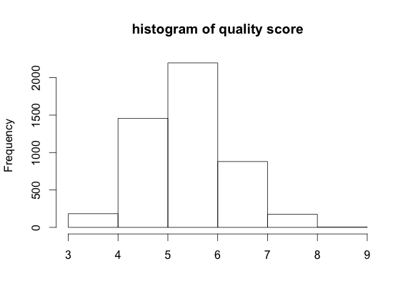
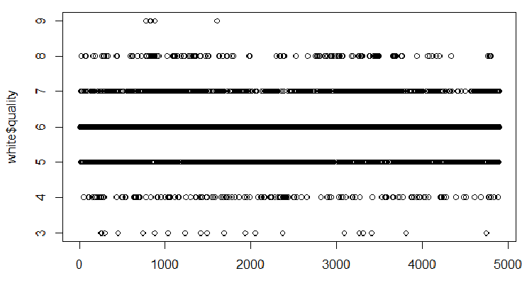
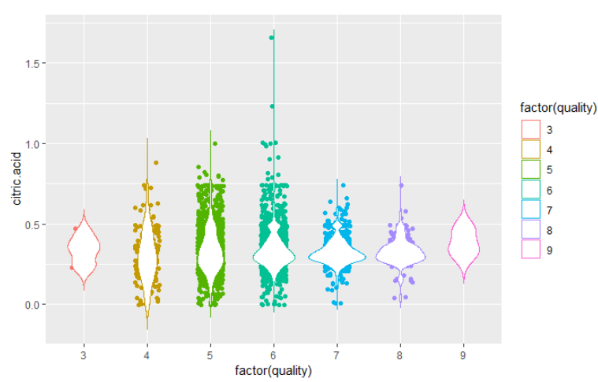
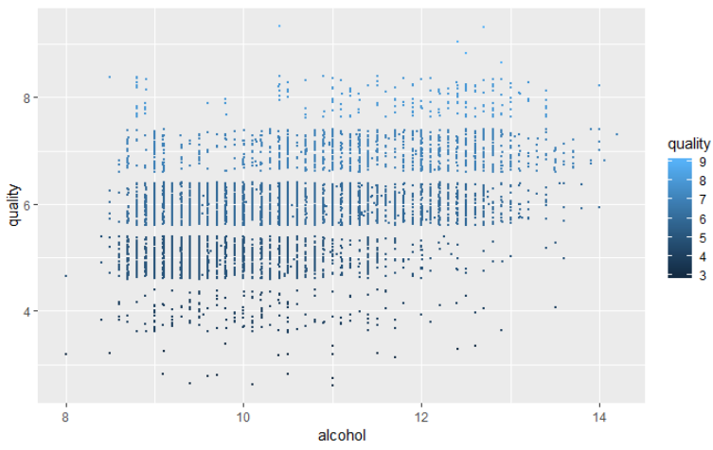
Figure 2. Uneven distribution of observers by quality scores
Scatter plot
Violin plot

Slide 9
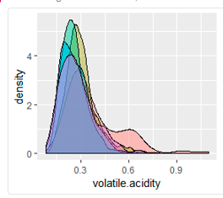
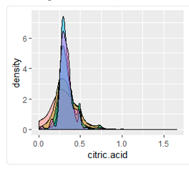
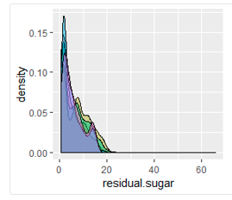
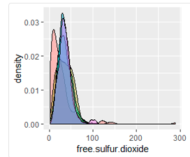
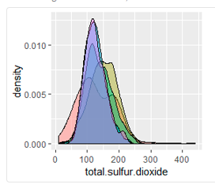
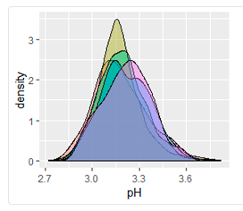
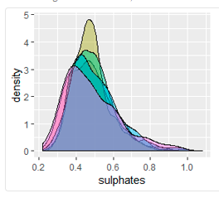
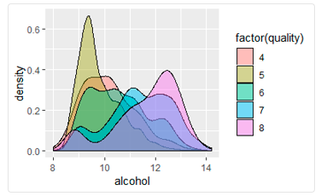
Figure 3. Density plots of variable by scores of quality

Slide 10
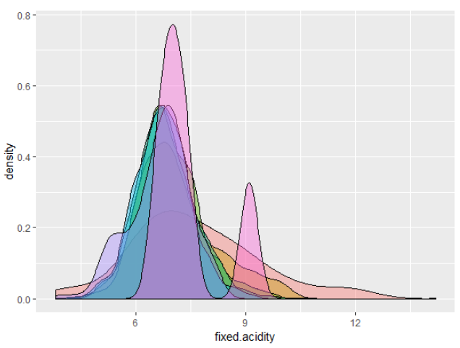
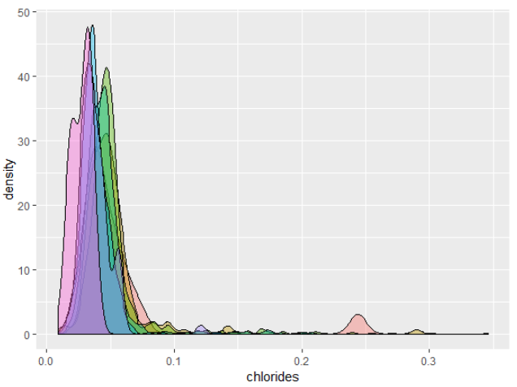
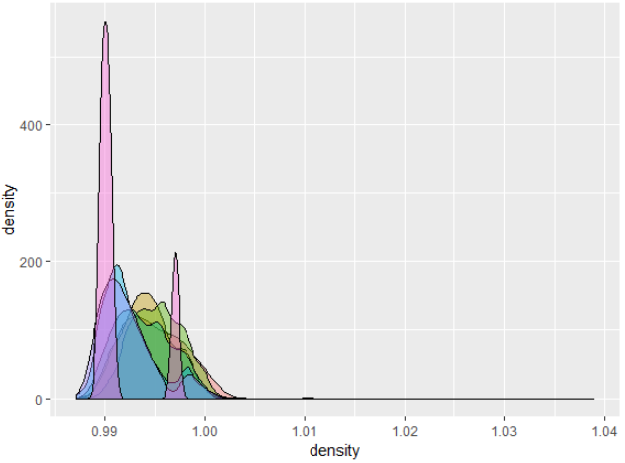
Figure 1. Continue

Slide 11
Tabel 3. means of different variable by score of wine quality
variables | 4 | 5 | 6 | 7 | 8
fixed.acidity | 7.18 | 6.93 | 6.83 | 6.73 | 6.67
volatile.acidity | 0.37 | 0.30 | 0.26 | 0.26 | 0.27
citric.acid | 0.30 | 0.33 | 0.33 | 0.32 | 0.32
residual.sugar | 4.82 | 7.33 | 6.44 | 5.18 | 5.62
chlorides | 0.05 | 0.05 | 0.04 | 0.03 | 0.03
free.sulfur.dioxide | 26.63 | 36.43 | 35.65 | 34.12 | 36.62
total.sulfur.dioxide | 130.23 | 150.90 | 137.04 | 125.1 | 125.88
density | 0.99 | 0.99 | 0.99 | 0.99 | 0.99
pH | 3.18 | 3.16 | 3.18 | 3.21 | 3.21
sulphates | 0.47 | 0.48 | 0.49 | 0.50 | 0.48
alcohol | 10.17 | 9.80 | 10.57 | 11.36 | 11.65

Slide 12
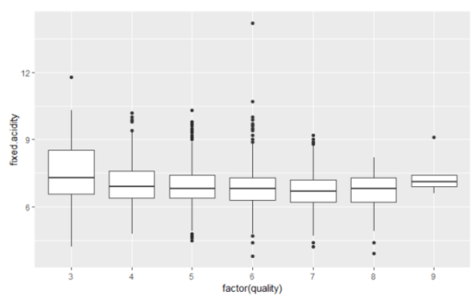
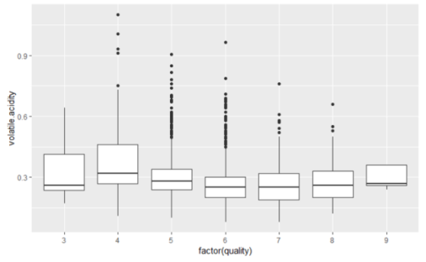
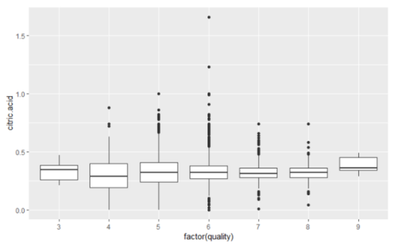
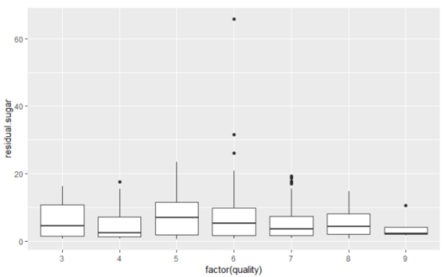
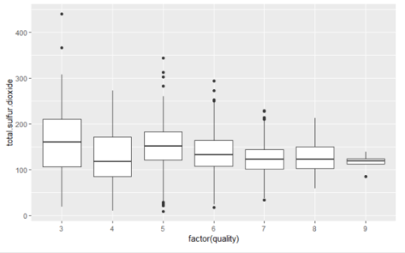
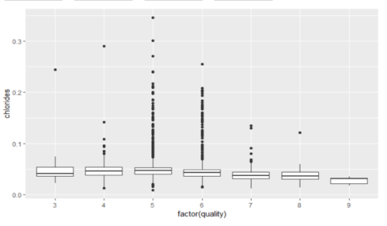
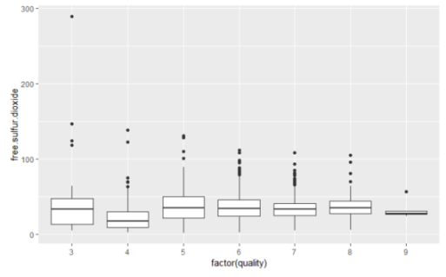
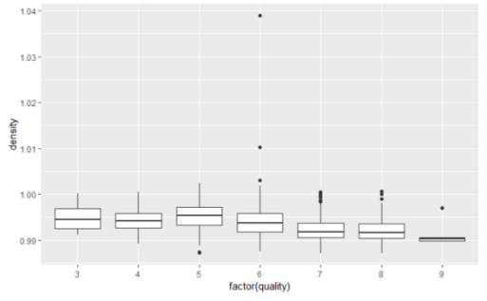
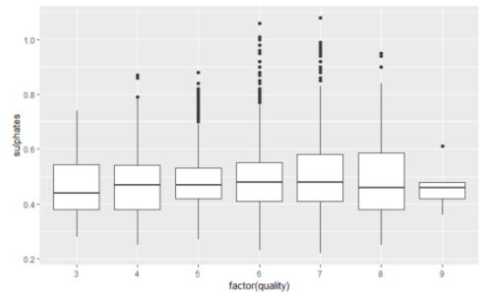
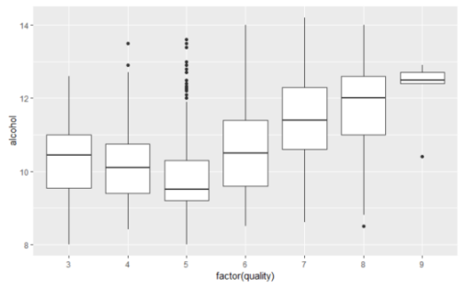
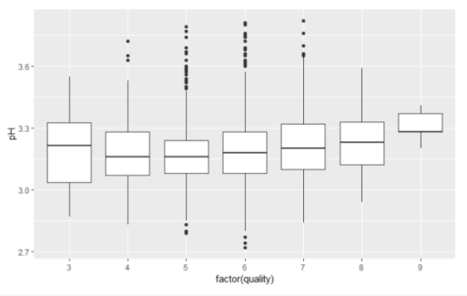
Figure 4. Boxplot of variables by score of quality

Slide 13
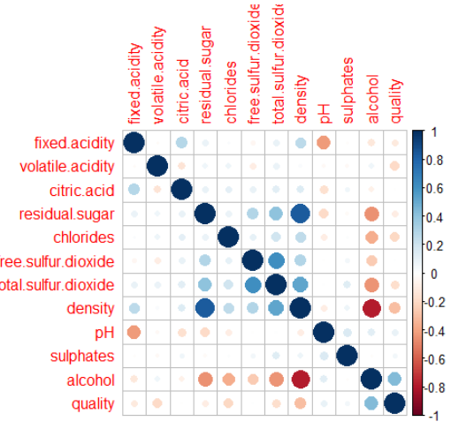
Figure 5. Correlations between variables

Slide 14
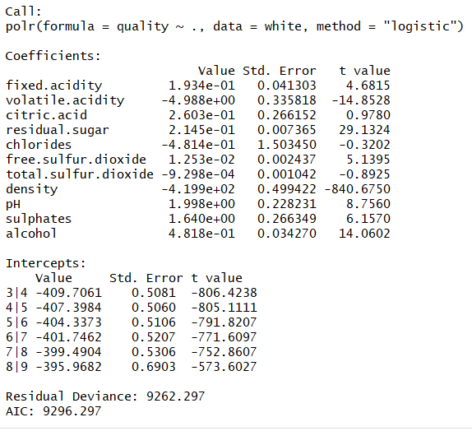
Figure 6. Summary of analysis of ordinal logistic regression model with all variables

Slide 15
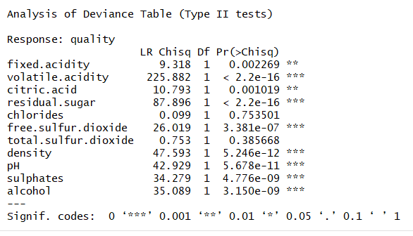
Figure 7. Comparing association of variables with quality

Slide 16
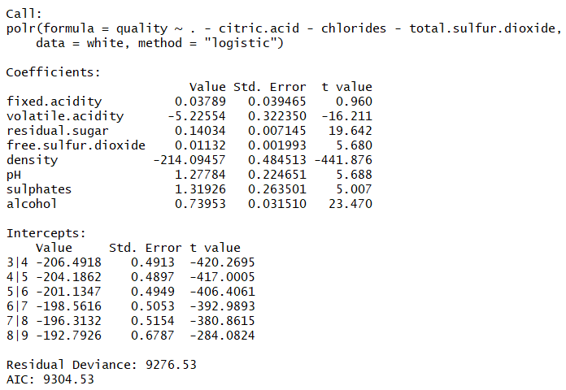
Figure 8. Slightly increase of residual deviance and AIC values in significant variable model.

Slide 17
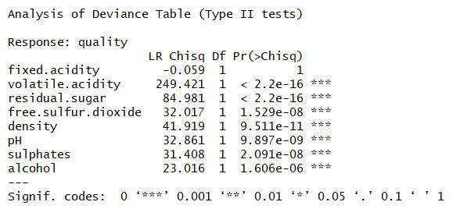
Figure 9. Significant association with quality scores

Slide 18
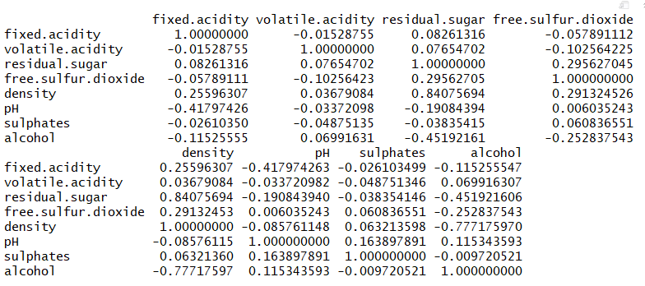
Figure 10. Correlation matrix of wine quality data showing collinearity between variables

Slide 19
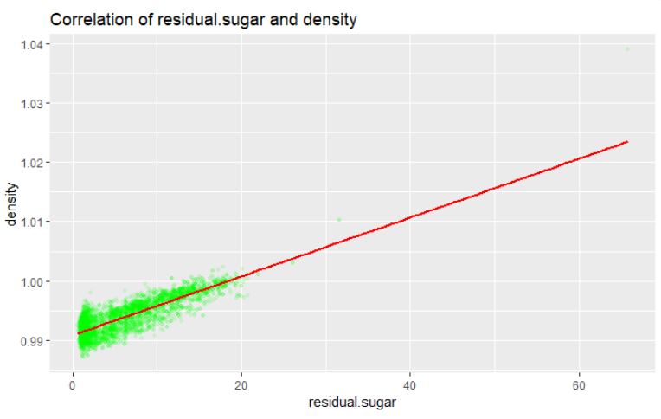
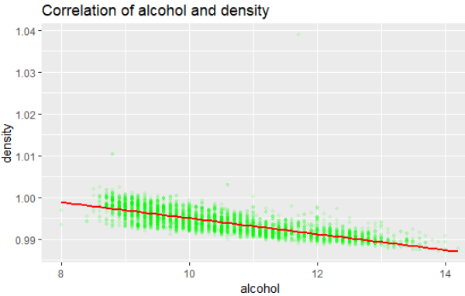
Figure 11. Scatter plot showing correlations between density and residual.sugar/alcohol

Slide 20
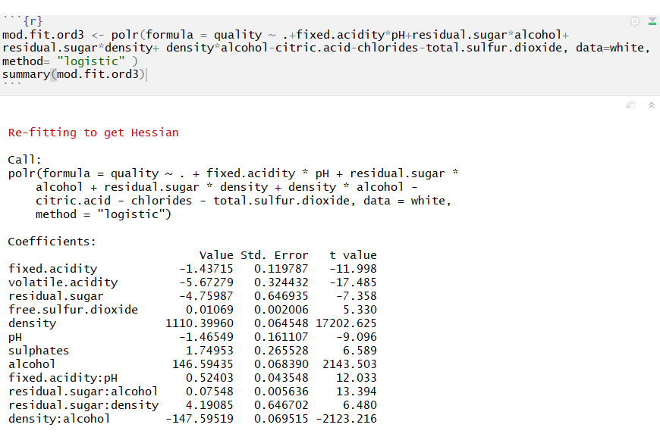
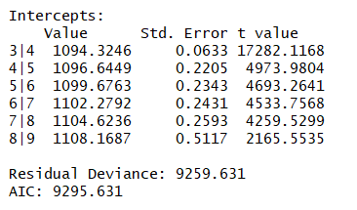
Figure 12. Justification collinearity of ordinal logistic model

Slide 21
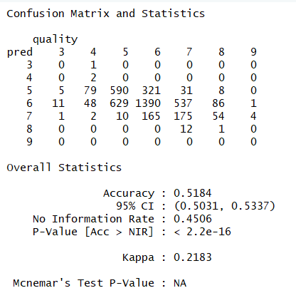
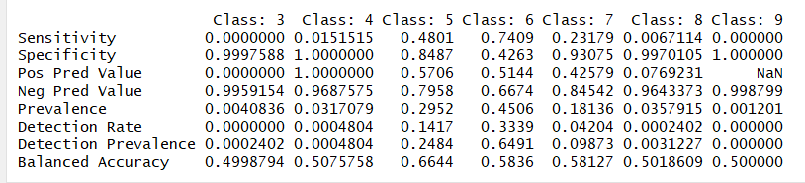
Figure 13. Confusion Matrix of Model 3

Slide 22
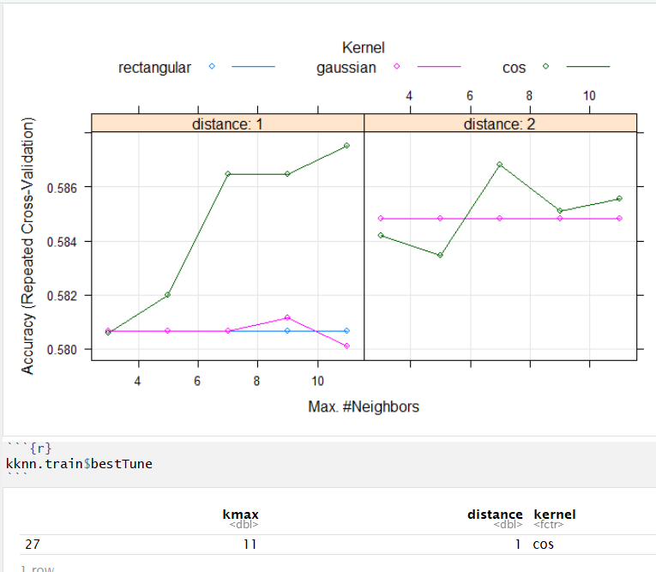
Figure 14. knn full model

Slide 23
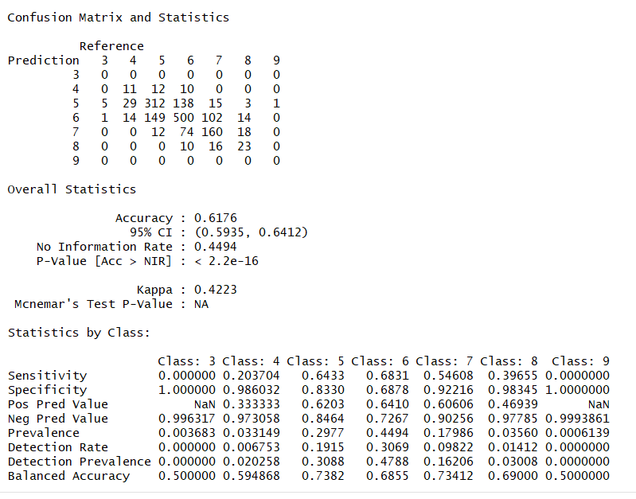
Figure 15. Confusion matrix and statistics of k-NN full model

Slide 24
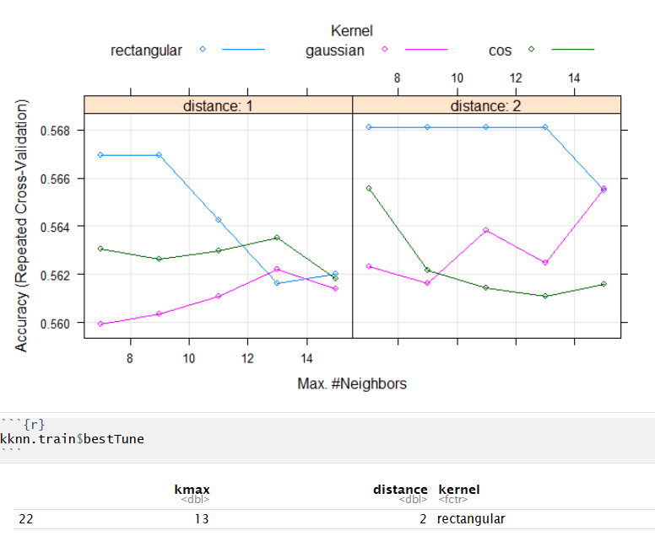
Figure 16. knn reduced model

Slide 25
Table 18A. Compare major parameters of different models
 | KNN full model | KNN reduced | Ordered log. Full
Accuracy | 0.62 | 0.60 | 0.53
95% CI | 0.59-0.64 | 0.58-0.62 | 0.50-0.55
P Value | <2.2e-16 | <2.2e-16 | <3.86e-9
Kappa value | 0.42 | 0.40 | 0.23

Slide 26
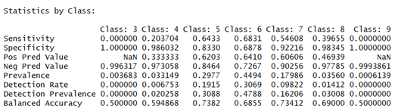
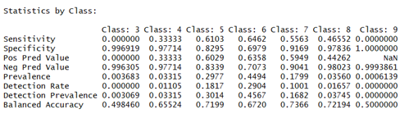
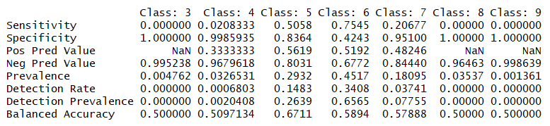
Table 18B. Compare statistics by classes in different models
KNN Full Model
KNN Reduced Model
Ordered
Logistic
Regression

Slide 27
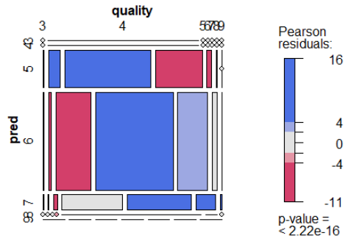
Figure 19. Mosaic plot of model 3

Slide 28
Conclusion
Quality of wine can be predicted by the following variables: “alcohol”, “residual.sugar”, “pH”, “fixed.acidity”, “volatile.acidity” and “free.sulfur.dioxide”.
Outlinears and collinearity are needed to be justified for ordinal logistic regression models but not knn models.
K-nn models performs better than ordinal logistic regression models because most of the independent variables are not linear related to the response variable.
All the ordinal regression models and knn models are failed to predict wine quality scores of “3” and “9” due to lack of cases fit into that two category.
Although collapsed categories can improve prediction accuracy, it loses prediction power. It is not wise to collapsed the categories in this study.
A large discrepancy between observed and expected values is due to the blind spots of models. There are still room for improve the knn models. But the computational cost will be increased significantly.

